Slide 1
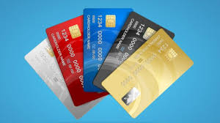
CREDIT CARD SPENDING HABIT IN INDIA
Submitted by
Angel Jacob
Data Analytics , 2025

Slide 2
"Money is a tool. Used properly, it makes something beautiful; used wrong, it makes a mess." — Brad Klontz, financial psychologist

Slide 3
Absract
The credit card spending habit in India ,revealing a rising trend in digital payments.
It highlights increased expenditures on travel , entertainment and online shopping .

Slide 4
Introduction
A credit card is a payment card, usually issued by a bank, allowing its users to purchase goods or services, or withdraw cash, on credit.

Slide 5
Objectives
To visualise customer credit card spending habit in India between 2013 to 2015.
To provide spending habit of customers using credit card across different regions in India.
To analyse customer trends and interests based on gender.

Slide 6
Data set
Source of dataset : Kaggle
Number of columns : 8
Number of rows : 20000+
Time period : 2013 - 2015

Slide 7
Visualization
Purpose
For creating interactive and insightful dashboards
Key visuals
Card : To shows the total transaction amount
100%stacked bar chart: To find Transaction amount by gender wise
Donut chart: to shows the Spending amount by card type
Funnel chart : To identify Spending by top N cities
Line chart: To analyse the Transaction amount by year month and gender
Tree map: to shows the spending amount by expenditure type
Slicer: period , gender, card type, expenditure type

Slide 8
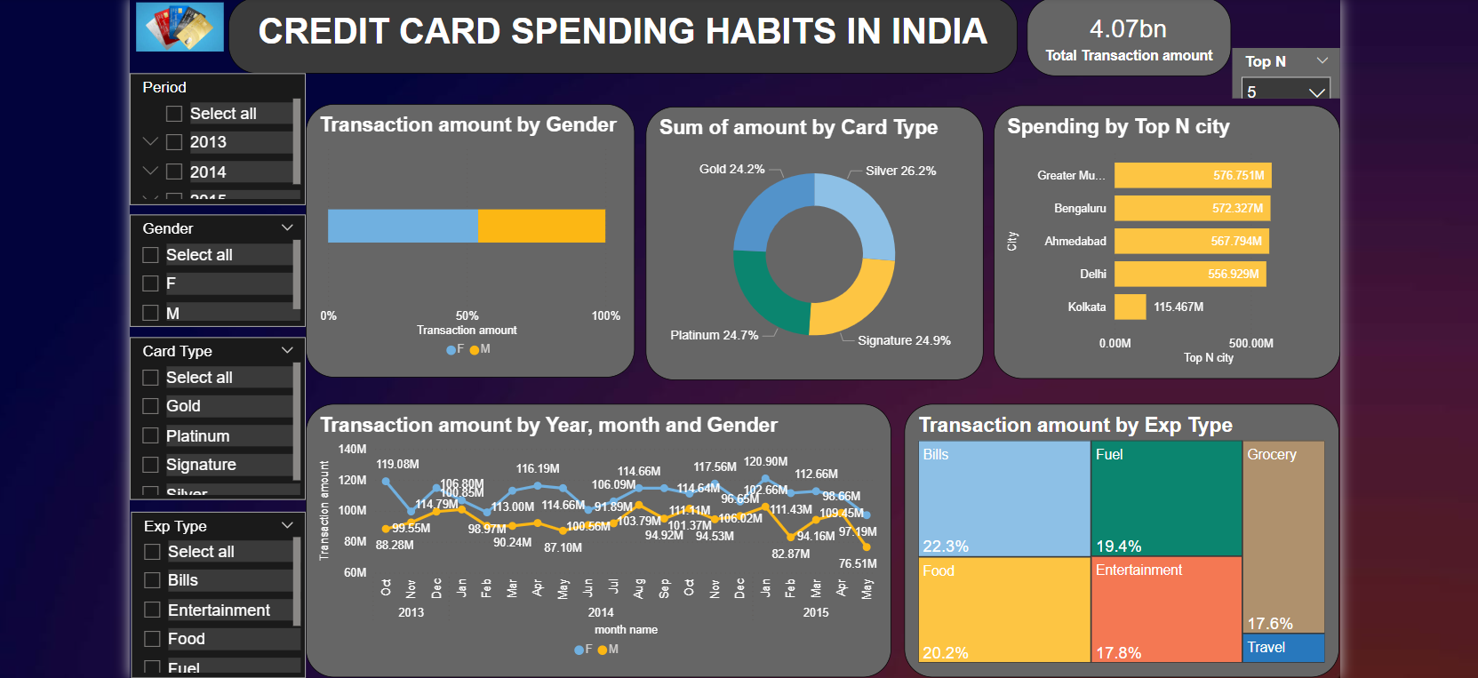

Slide 9
Insights
Top 5 cities Delhi ,greater Mumbai ,Ahmedabad , Bengaluru and Kolkata
Maximum expenses on bills and foods are 22.3% and 20.2% .
Credit card spending by females(55%) is more than males(45%)
Silver card are more in use compared to others.

Slide 10
Recommendation
Strengthen fraud detection system(improve security)
Targeted reward programs(cashback and rewards)
Promote financial literacy(educate on interest rate, timely repayment)

Slide 11
Conclusion
India’s credit card usage is expanding rapidly
By understanding credit card spending habits, business and financial institutions can better tailor their products and services to meet the needs of their customers.

Slide 12
THANK YOU

